Slide 1


Pei Hwa Hackathon 2026
Innovating with Kindness:
Caring for People and the Planet
Students participants training

Slide 2

INTRODUCTION
The hackathon challenges students to design and build innovative prototypes that address real-world problems, guided by the theme “Innovating with Kindness: Caring for People and the Planet.”
Full information:
https://phss.epc-education.com/hackathon-2026

Slide 3

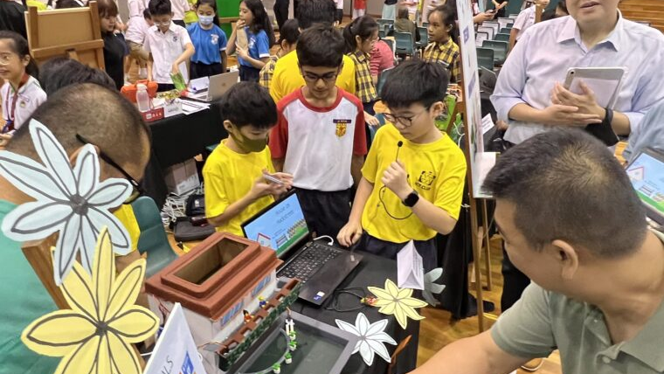
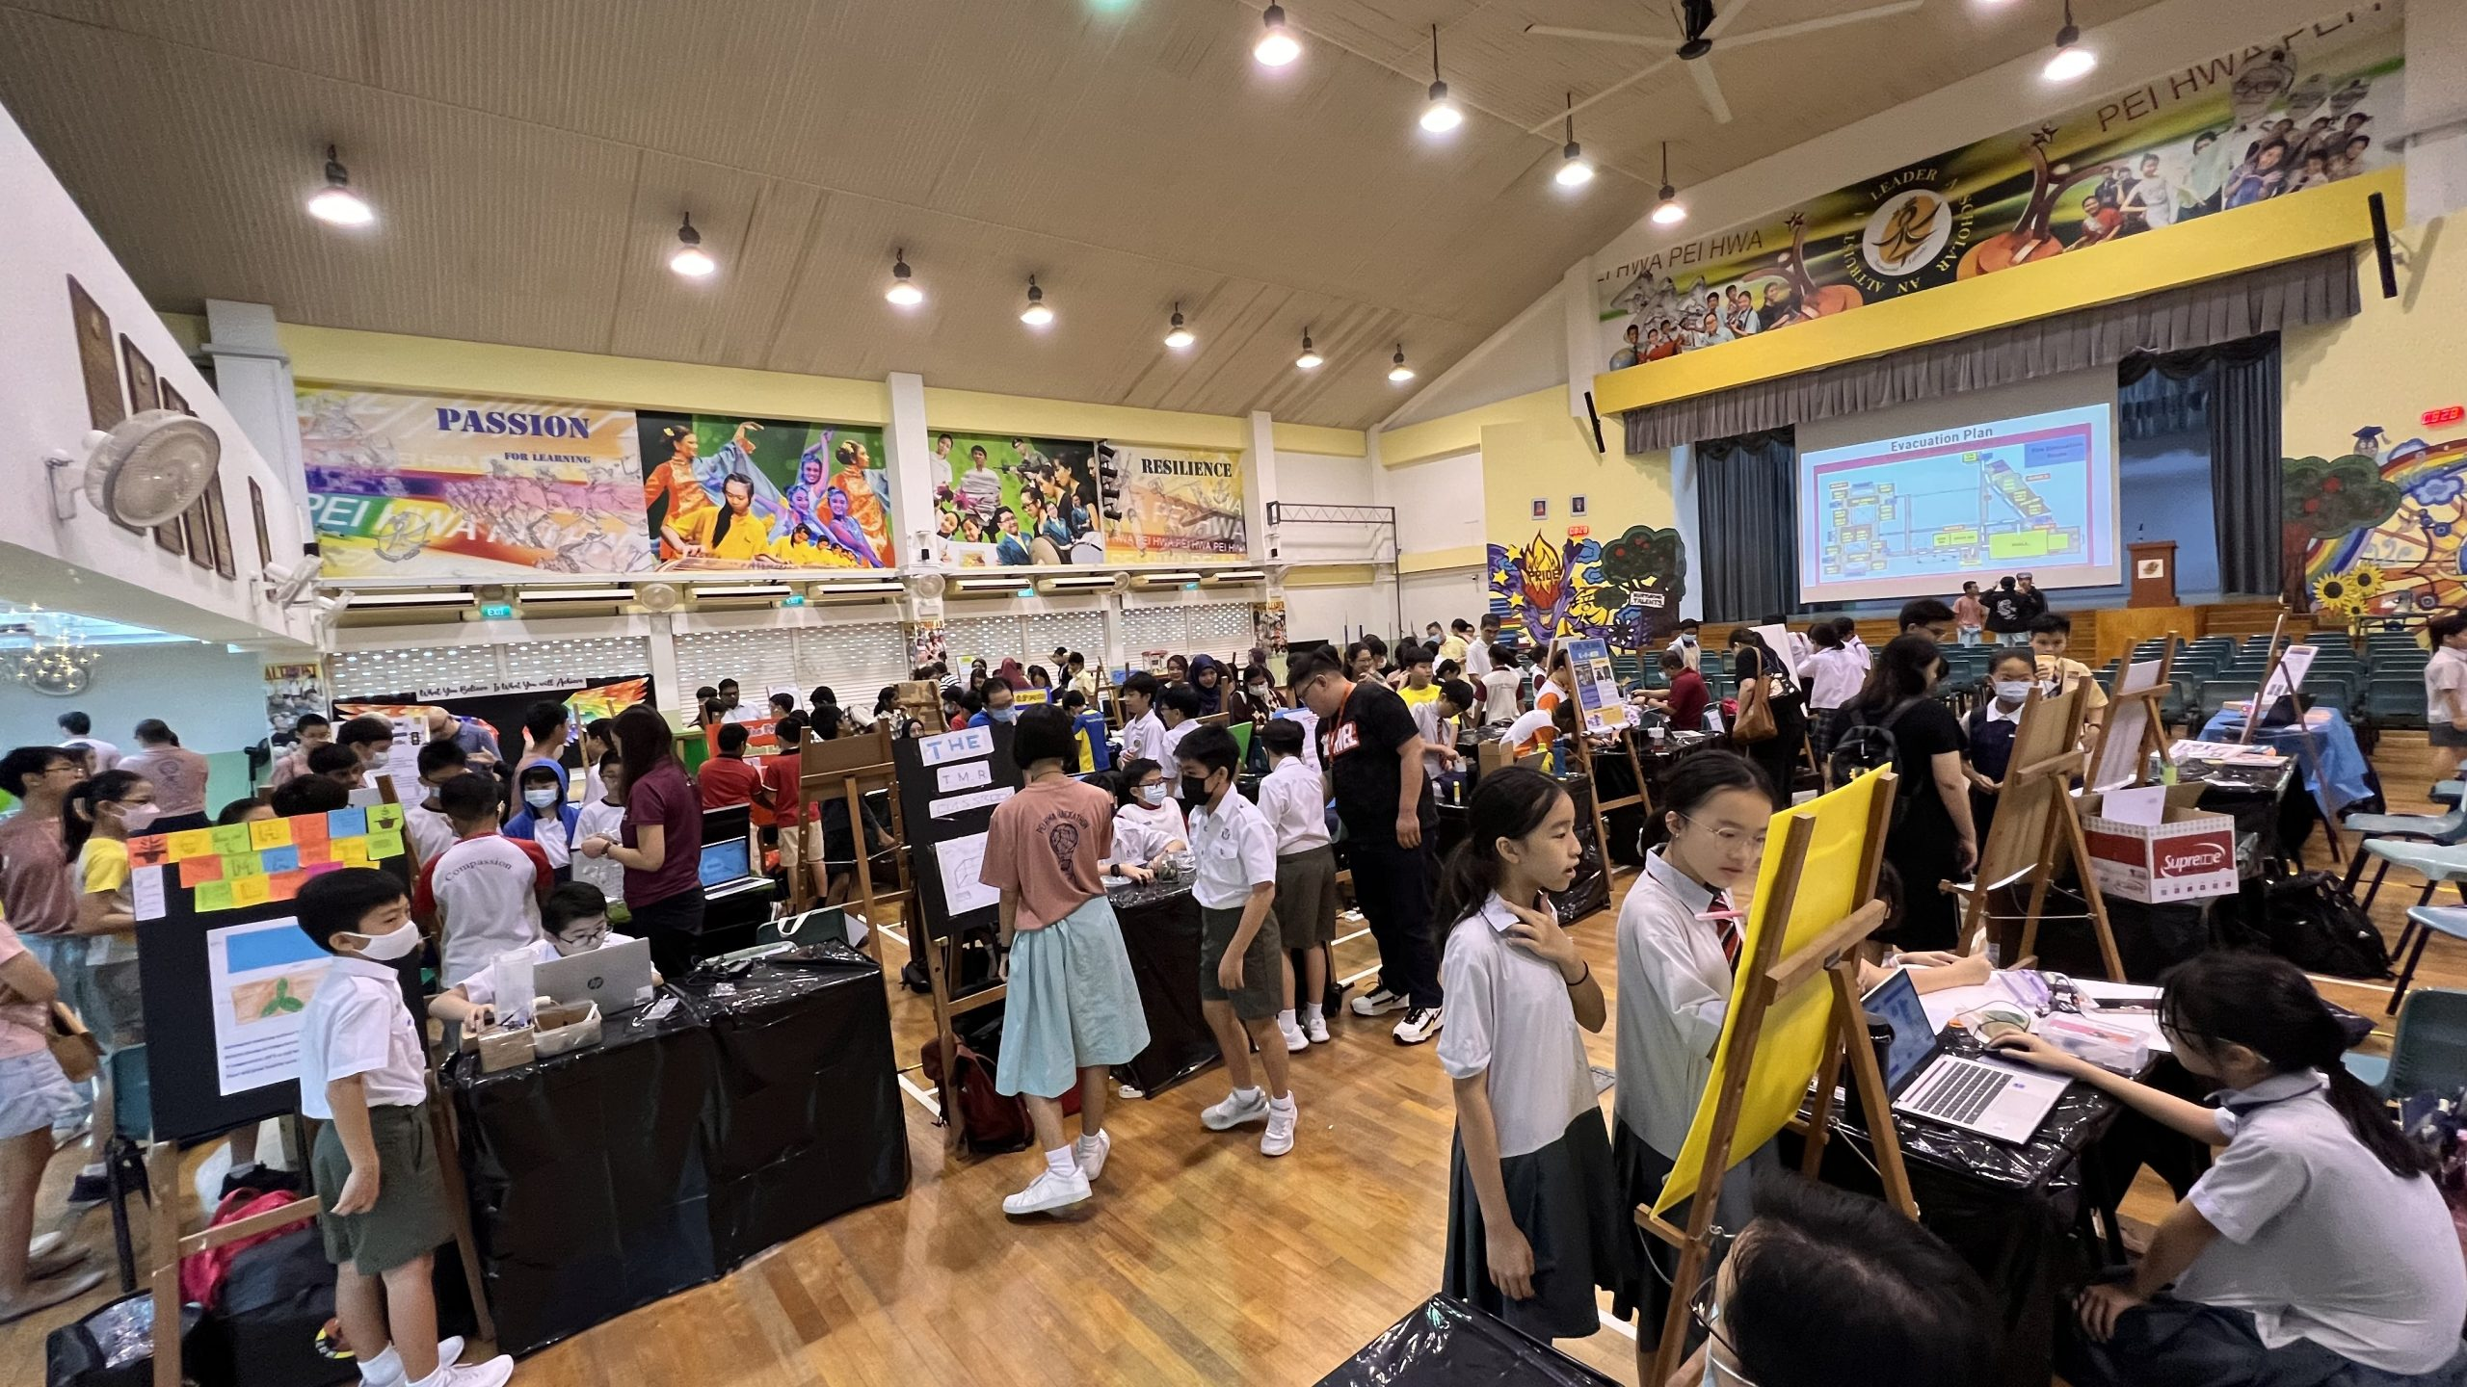
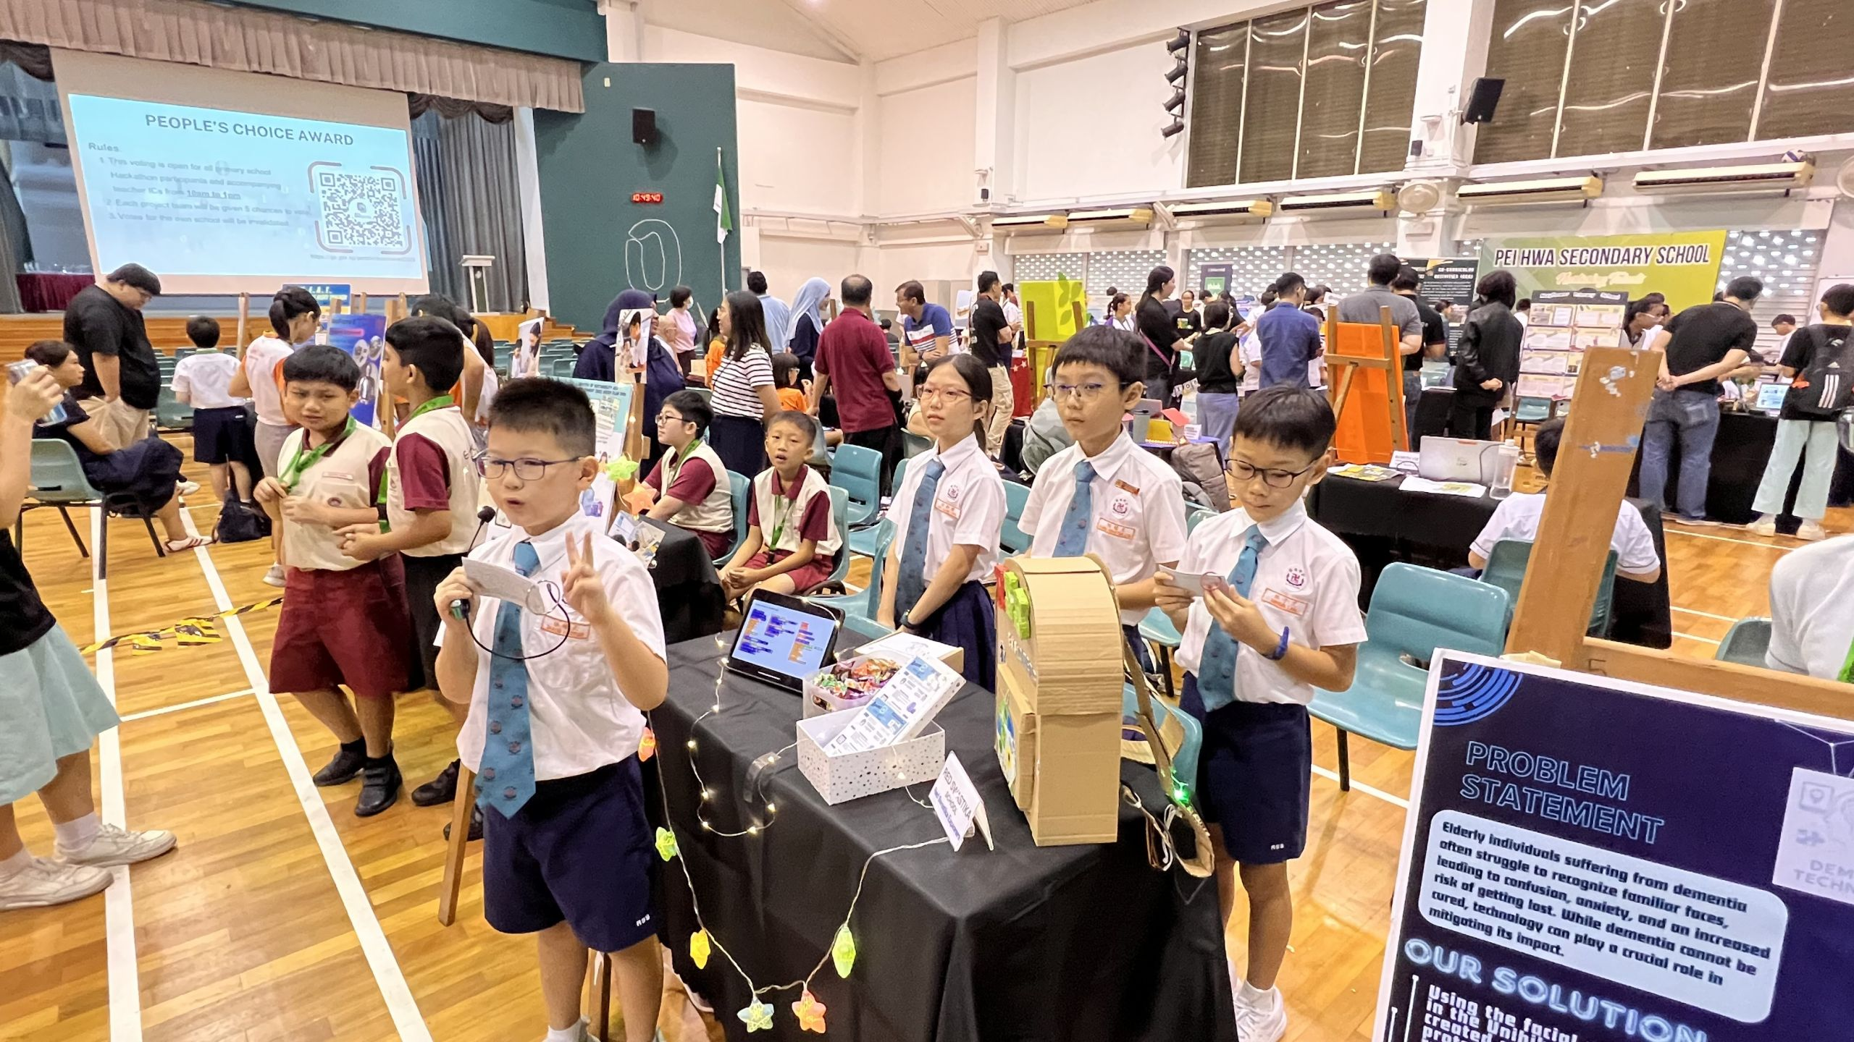
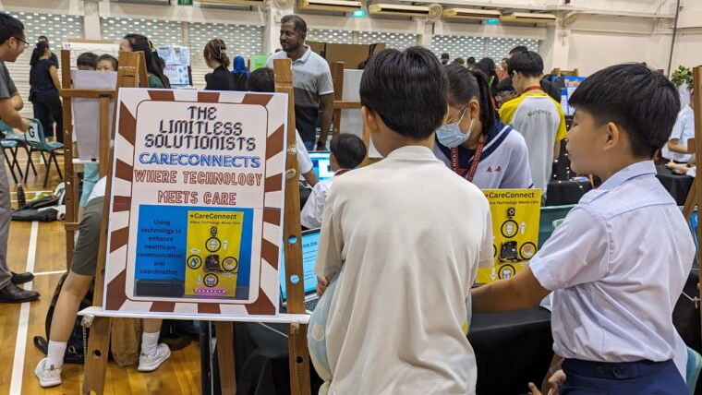

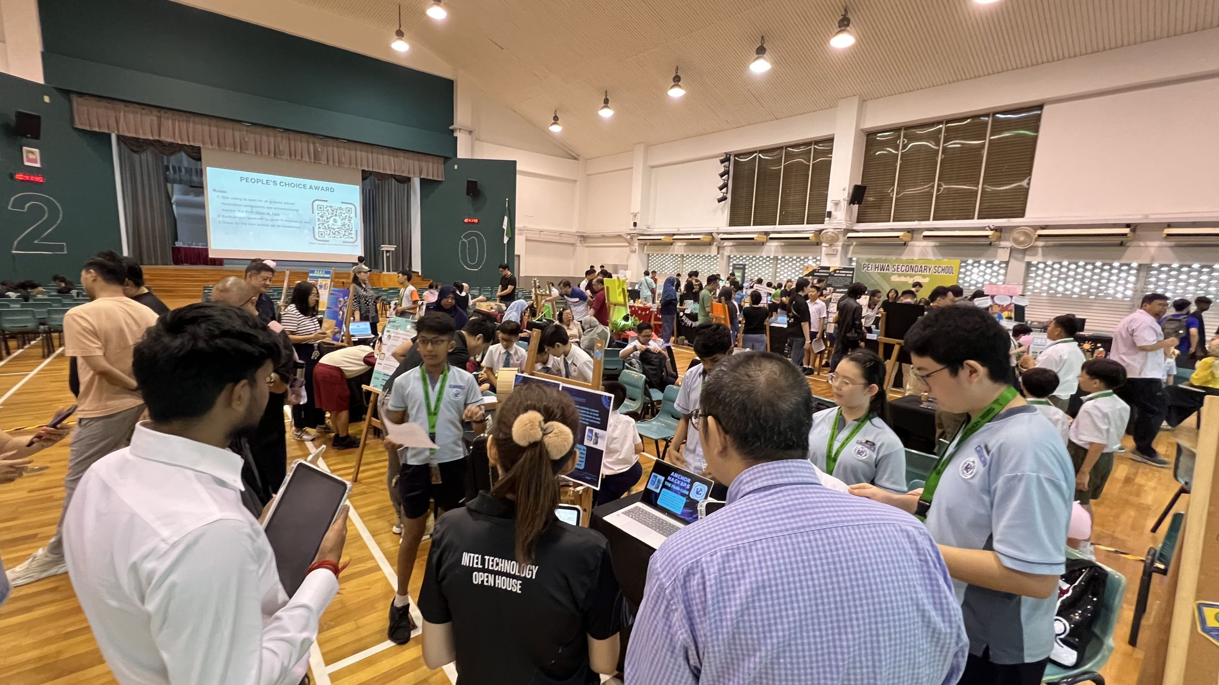

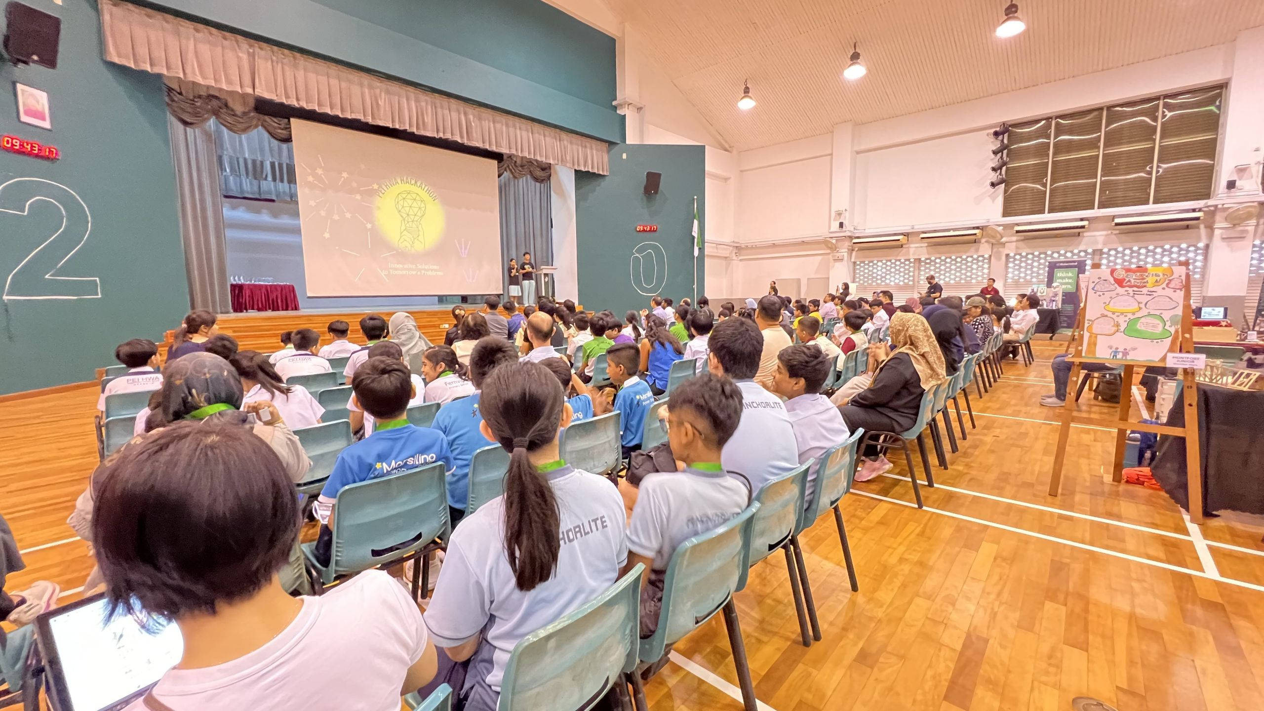
PEI HWA HACKATHON JOURNEY

Slide 4
YOUR ROLE
As a participant, your role is to explore ideas, work collaboratively, and create meaningful solutions based on the given theme. This is not just about building a working prototype—it’s about the process of thinking, experimenting, and improving your ideas.
Be open to trying new things, learning from mistakes, and supporting your teammates. Take initiative, ask questions, and stay curious. Most importantly, focus on solving real-world problems in a thoughtful and creative way.
Work together as a team
Explore ideas and think creatively
Equip with the technical skills
Try, test, and improve your solutions
Learn from mistakes and challenges
Stay curious and take initiative

Slide 5
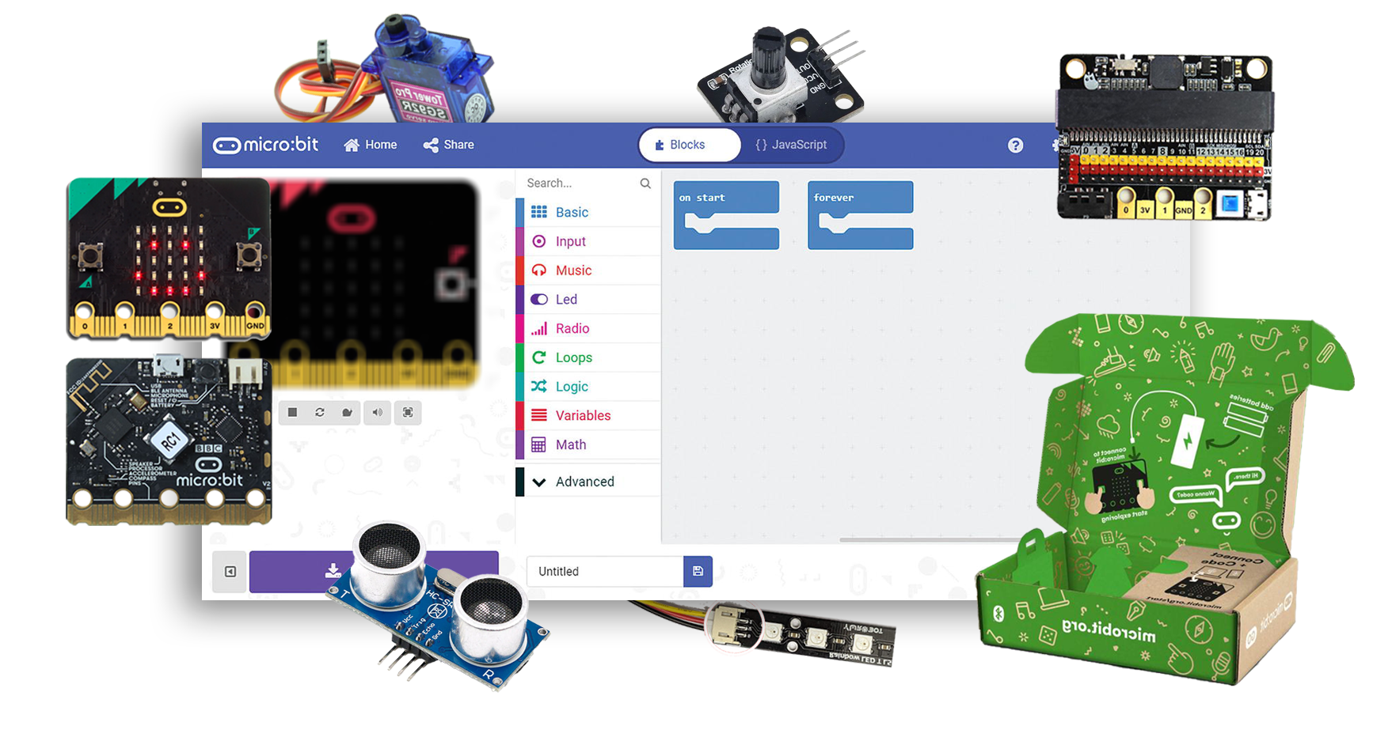
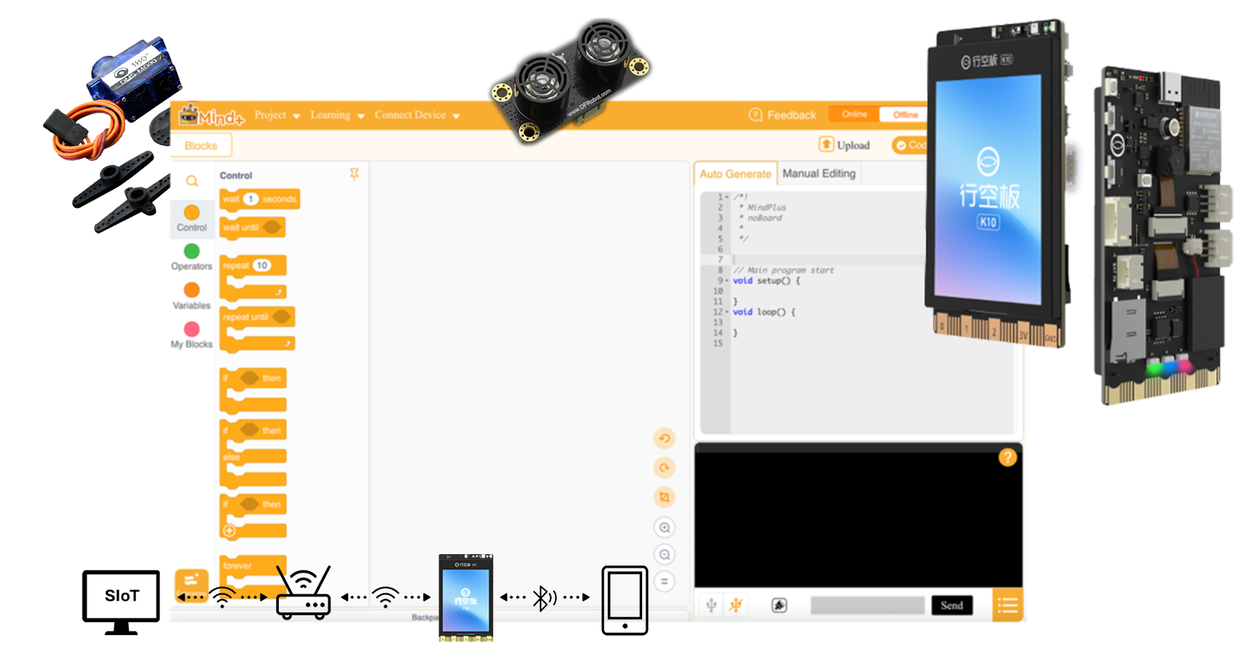
COMPONENTS & KIT
#OPTION 1 –
Micro:bit + External Components
#OPTION 2 –
Unihiker + External Components
Note: only the Unihiker kit will be provided (Unihiker K10 + Servo motor + Ultrasonic sensor)
The comparison between two controllers can be found on the website. Students are advised to ideate their possible solution and features needed first, then to determine which microcontroller would be more suitable for their project

Slide 6
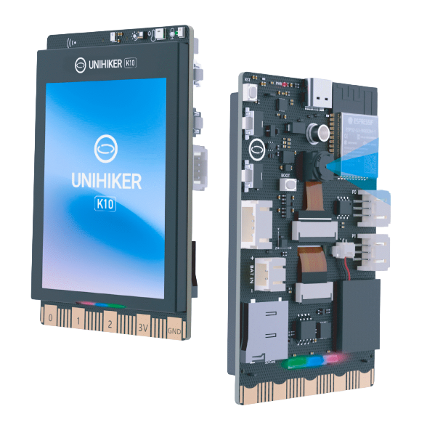
INTRODUCTION TO COMPONENT UNIHIKER K10
UNIHIKER K10 is an all-in-one development board designed for learning programming, IoT, and AI.
It features a built-in LCD screen, Wi-Fi and Bluetooth, camera, microphone, speaker, RGB indicator, and multiple sensors with expansion options.
With its highly integrated components, users can easily create IoT and AI projects such as face recognition, voice recognition, and speech synthesis without needing additional devices.

Slide 7
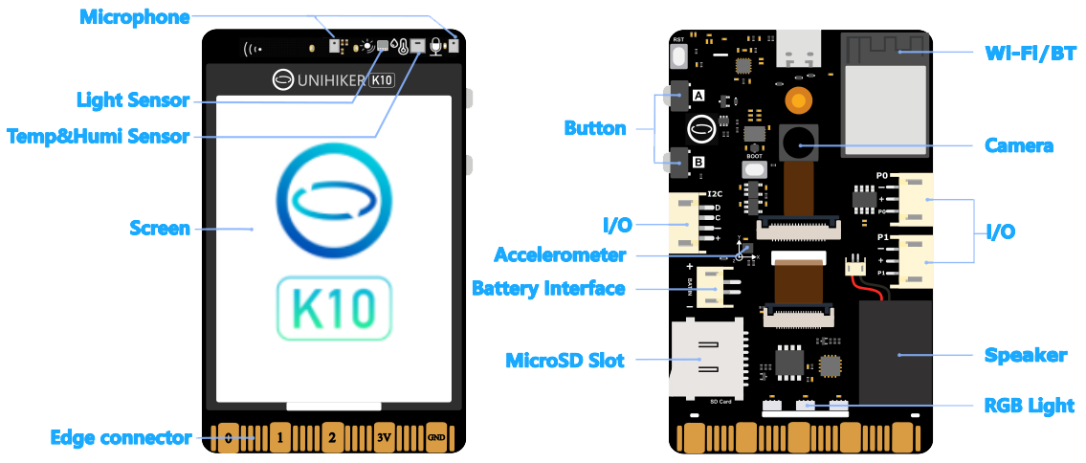
UNIHIKER K10 - FEATURES

Slide 8
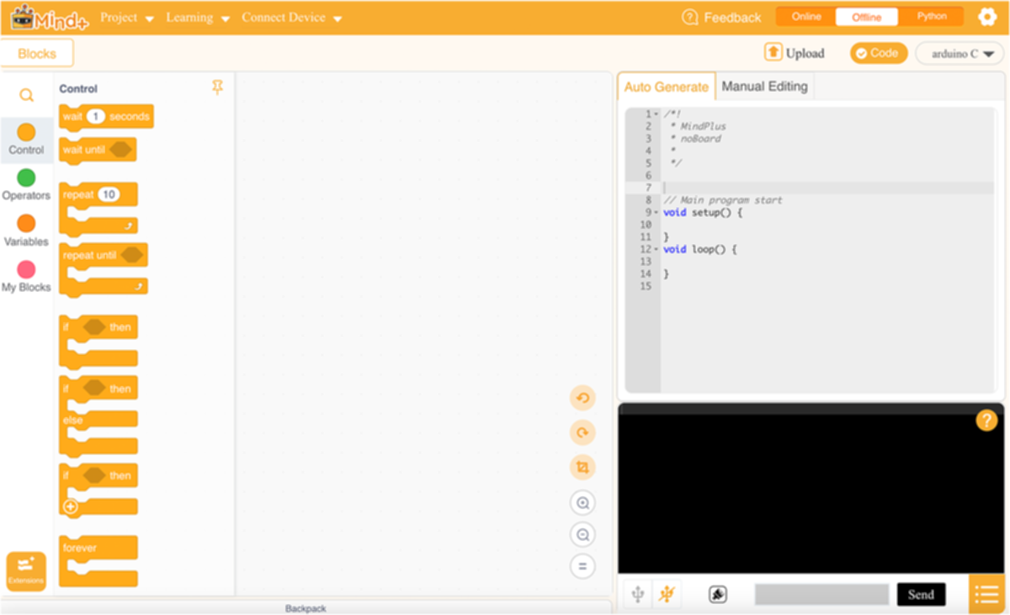
SOFTWARE MIND+
Mind+ is a user-friendly programming platform that you will use to code and interact with hardware like the UNIHIKER. It supports both block-based coding for beginners and text-based coding for more advanced users.
With Mind+, you can control sensors, create interactive programs, and explore simple AI and IoT applications.
Mind+ download link (Windows):
https://epc-education.com/software/mindplus-win.exe
Note: Only Mind+ windows version can support Unihiker K10.

Slide 9

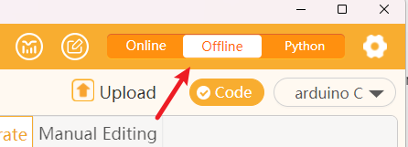
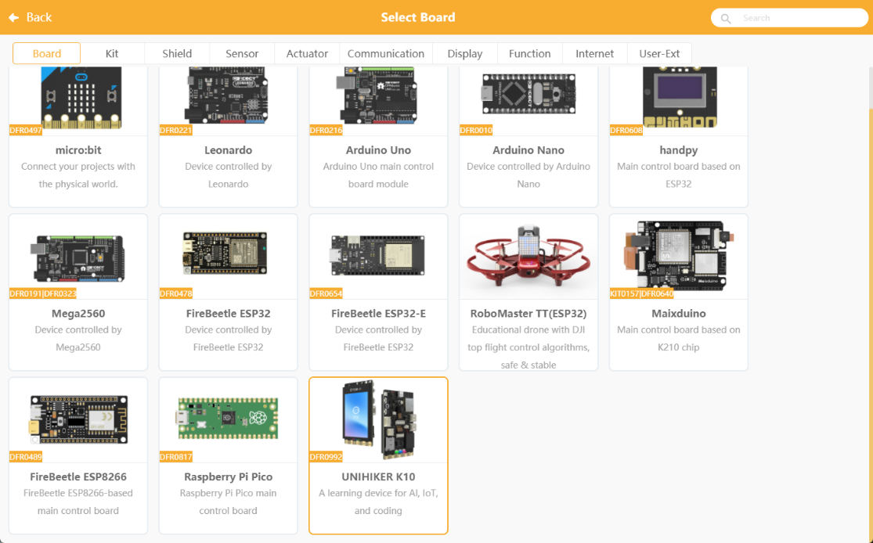
SETTING UP MIND+
01
Open Mind+
02
Switch to Offline mode
03
Click "Extension", in the extension page, click "Board", select "UNIHIKER K10". Click "Back" to finish loading.

Slide 10
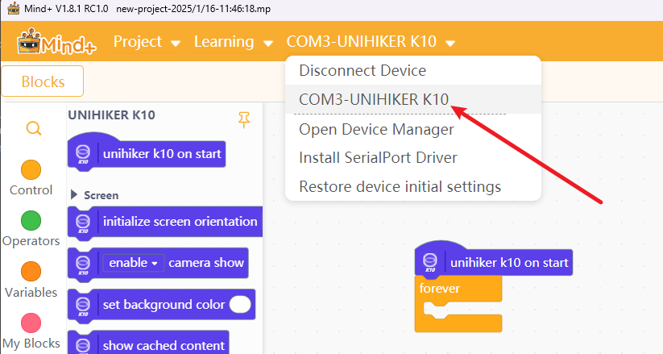
SETTING UP MIND+
04
Connect the Unihiker K10 to the computer using the USB A to C cable. Click “Connect Device” in Mind+, find the corresponding K10 device and click it to complete the device connection.

Slide 11
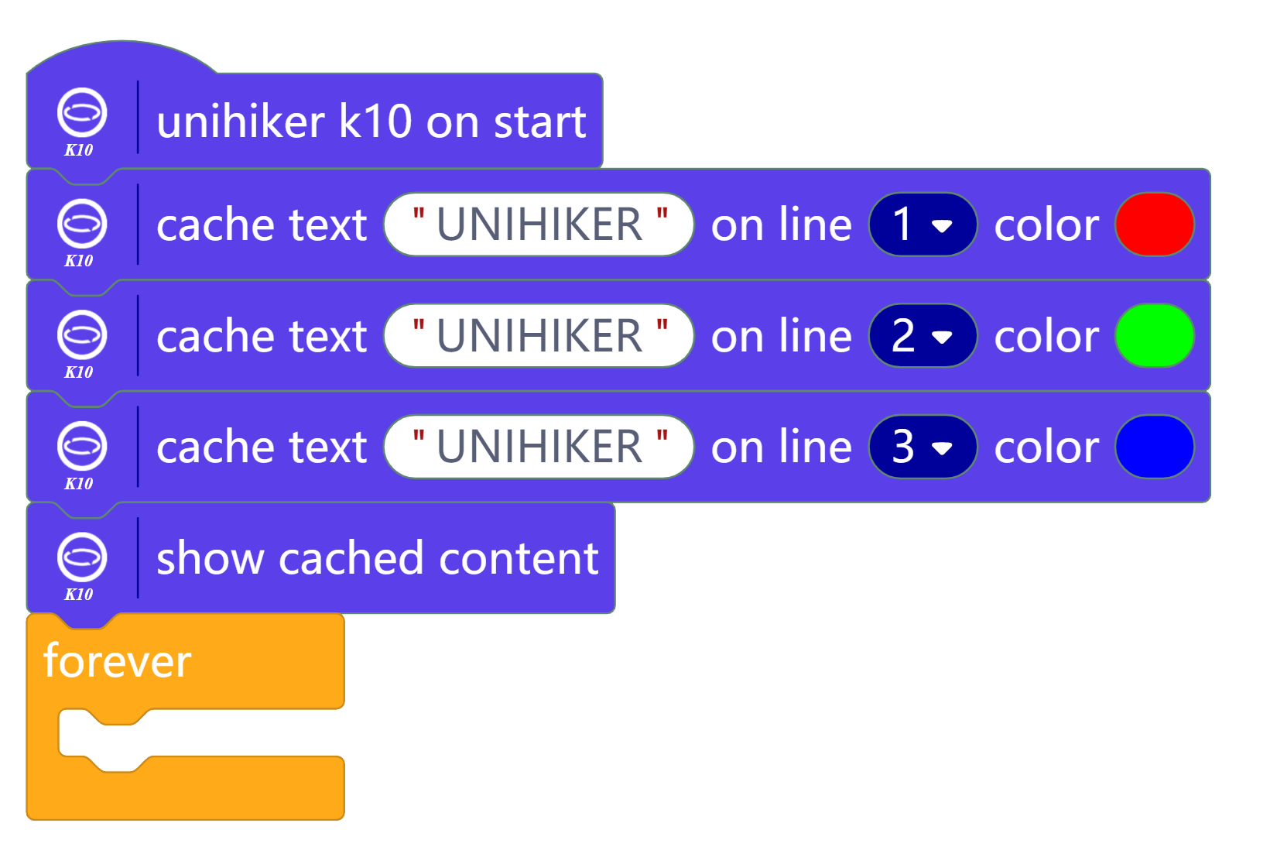
TESTING SETUP MIND+ + UNIHIKER K10
05
Try the following code blocks on the programming area

Slide 12
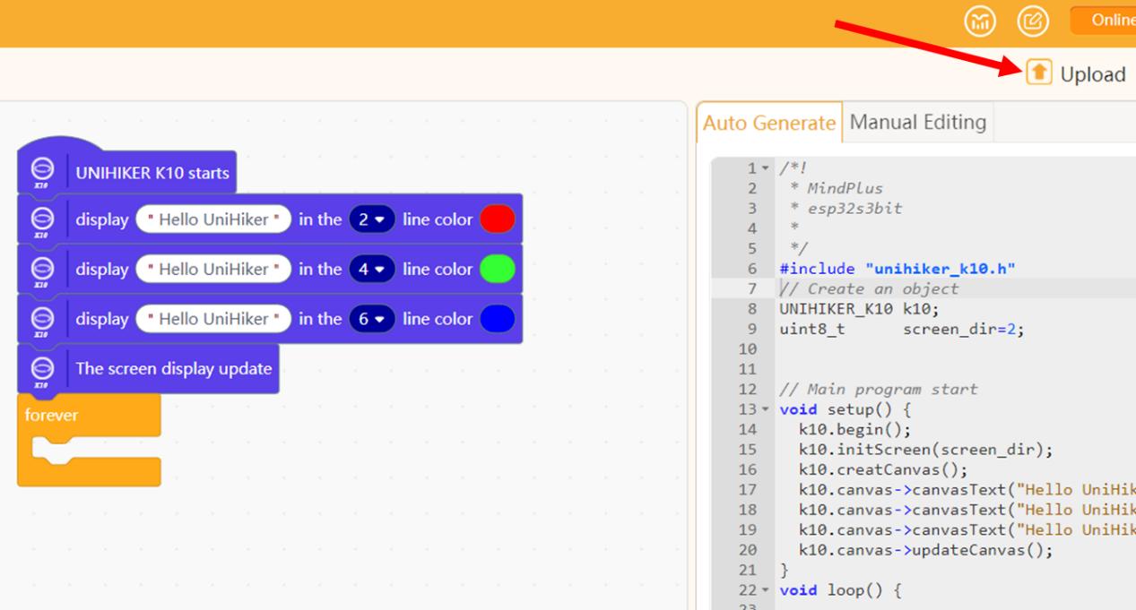
TESTING SETUP MIND+ + UNIHIKER K10
06
Click "Upload" and wait for the program to be flashed into the Unihiker K10. Observe the result on your Unihiker K10.

Slide 13
DID YOU FACED ANY ISSUES?
As you start working with the components and coding, things may not always work the first time—and that’s completely normal. Instead of immediately asking for help, take time to explore and troubleshoot the issue on your own.
Break the problem into smaller parts, test step by step, and think about what might be causing the issue. Try different solutions and learn from each attempt.
Remember, the goal is not just to get it working, but to understand how and why it works. Developing this problem-solving mindset will help you become more confident, independent, and successful throughout the hackathon.
Think Like a Problem Solver
Don’t panic when things don’t work—it’s part of learning
Break problems into smaller steps
Test and try different solutions
Think before asking for help
Learn from mistakes and keep improving

Slide 14
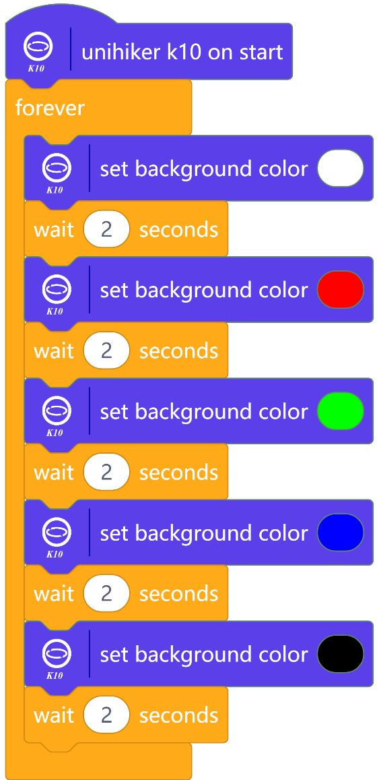
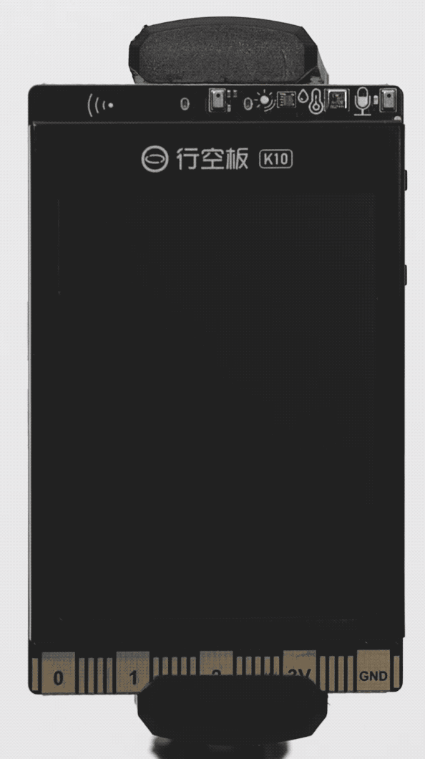
ACTIVITY 1: DISPLAY
Screen background colours
Notes:
Upload and observe the output on Unihiker k10

Slide 15
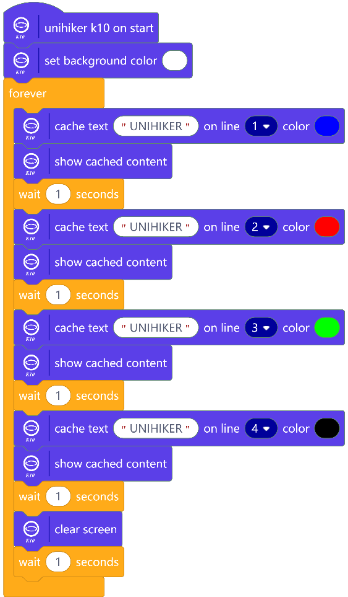
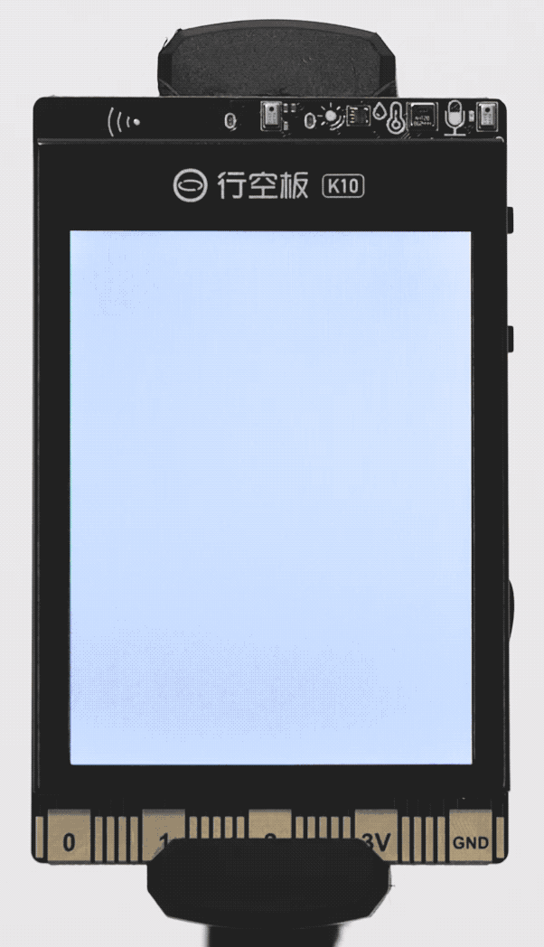
ACTIVITY 2: DISPLAY
Show Text
Notes:
Upload and observe the output on Unihiker k10

Slide 16
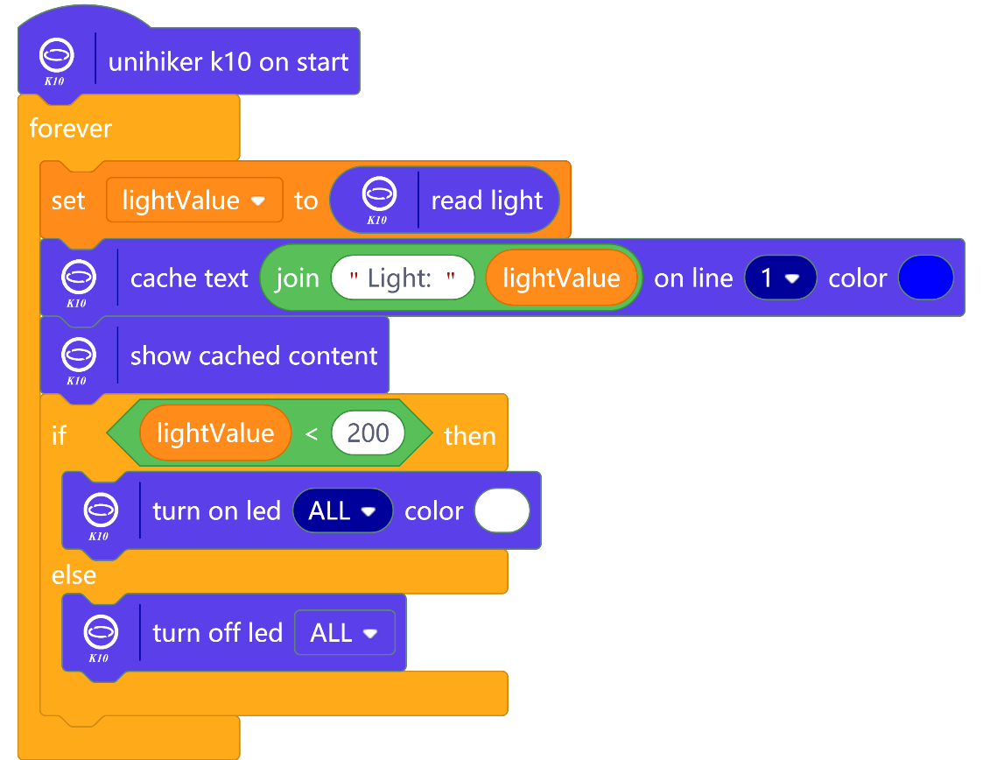
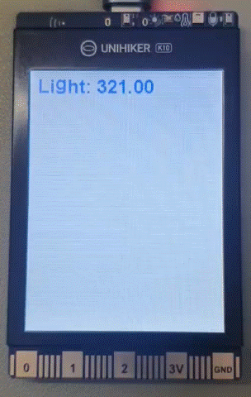
ACTIVITY 3: ON-BOARD COMPONENTS
LIGHT LEVEL
Note: Light sensor values measure ambient light in Lux. The lower the value the darker the ambient environment is.
Notes:
Upload and observe the output on Unihiker k10

Slide 17
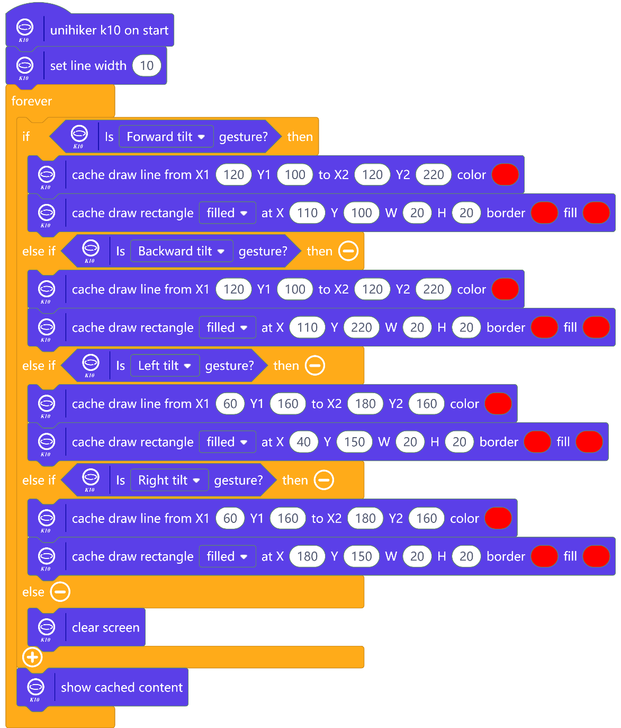
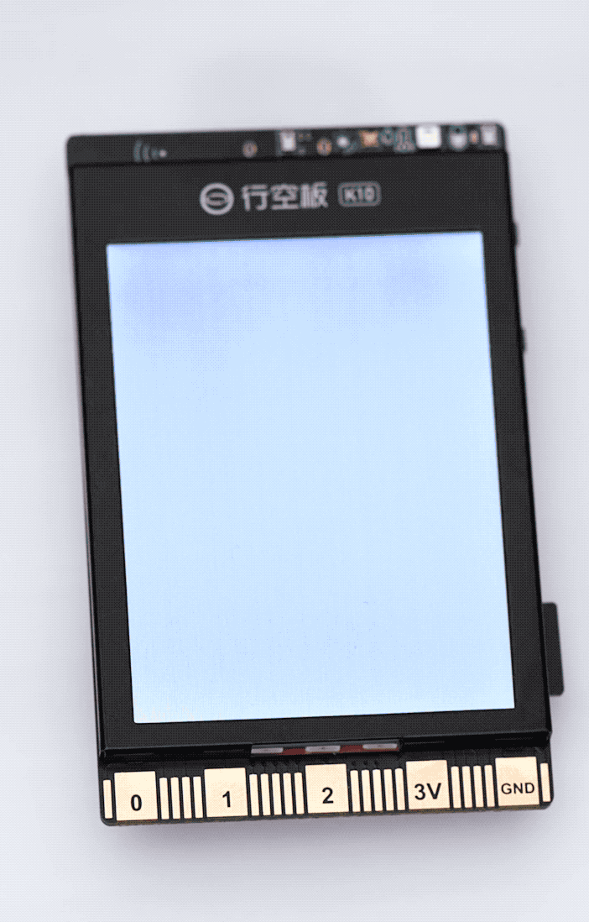
ACTIVITY 4: ON-BOARD COMPONENTS
ACCELEROMETER
Notes:
Upload and observe the output on Unihiker k10

Slide 18
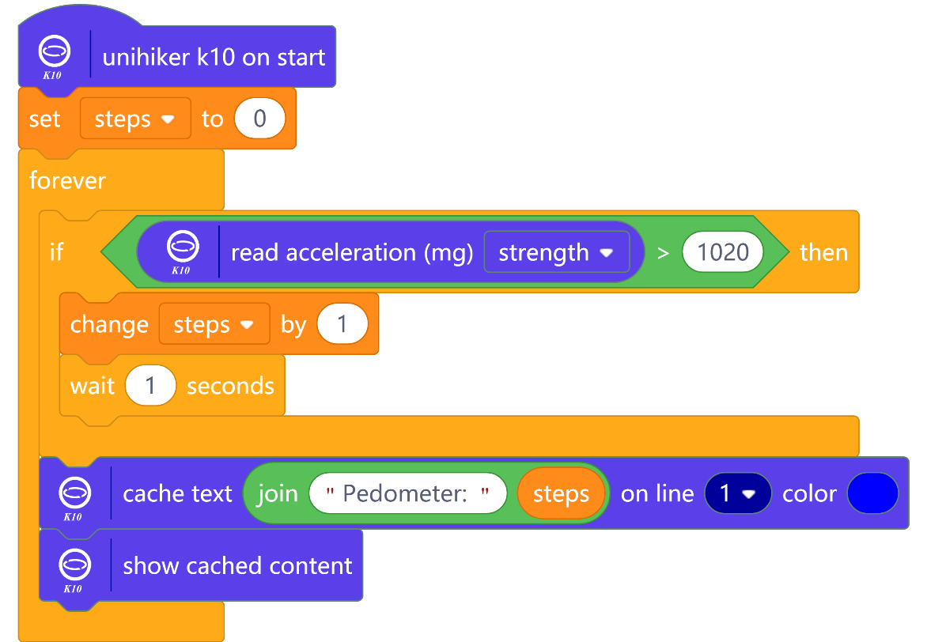
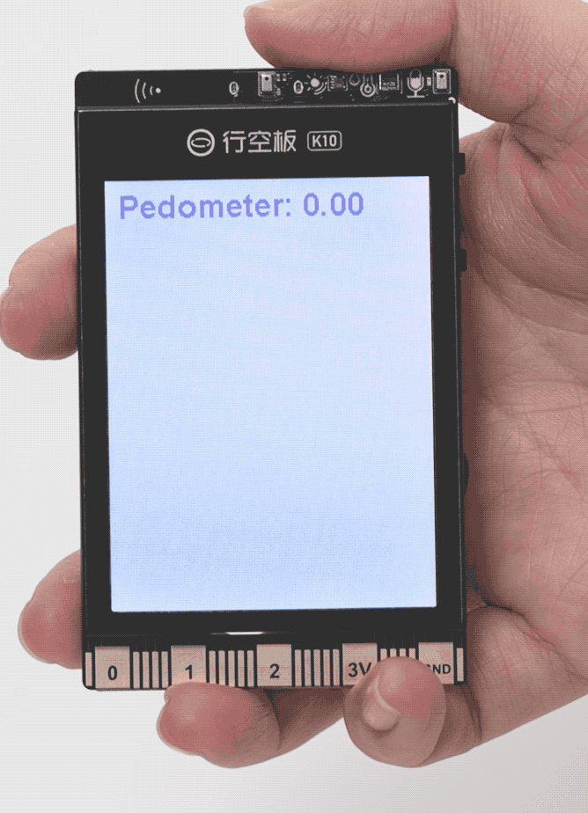
ACTIVITY 5: ON-BOARD COMPONENTS
ACCELEROMETER
Note: Strength means how hard the Unihiker needs to be shaken to register a step.
Notes:
Upload and observe the output on Unihiker k10

Slide 19
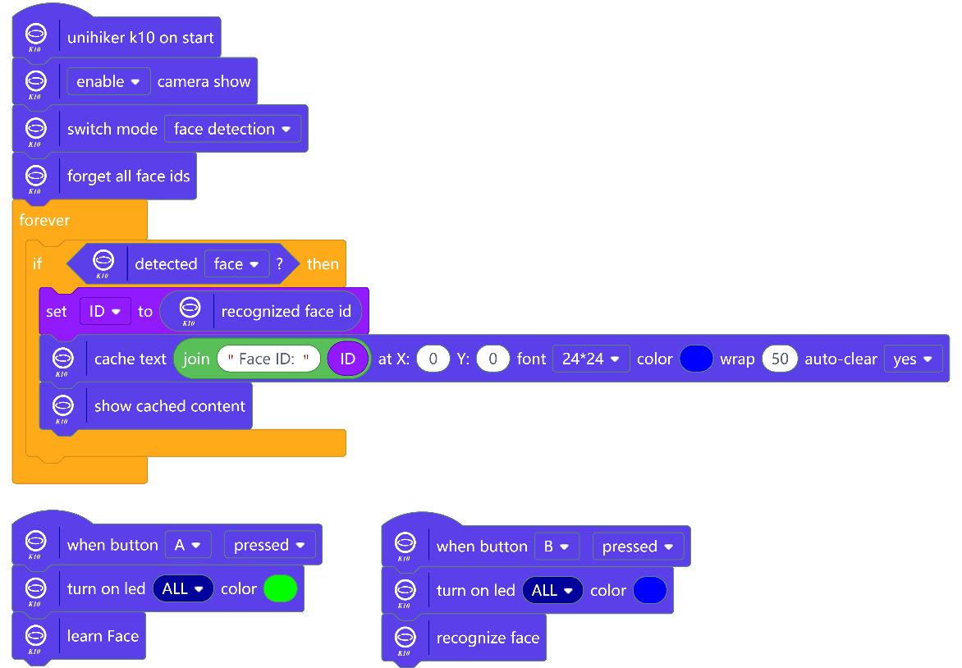
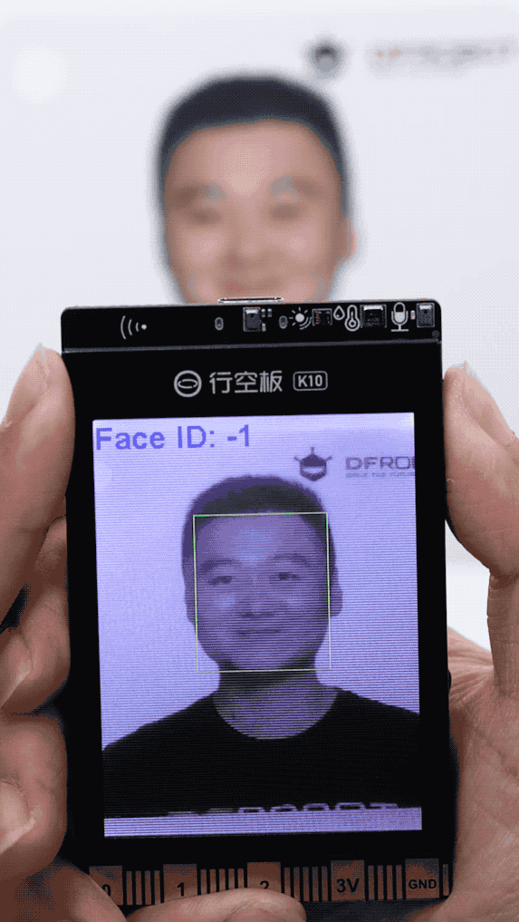
ACTIVITY 6: ARTIFICIAL INTELLIGENCE
FACE RECOGNITION
Note:
Search for clear faces images online
Press button A to learn a face. Each learnt face will be allocated a Face ID.
Press button B to recognize a face. If the Face ID is -1, then it means the face cannot be recognized.
Notes:
Upload and observe the output on Unihiker k10

Slide 20
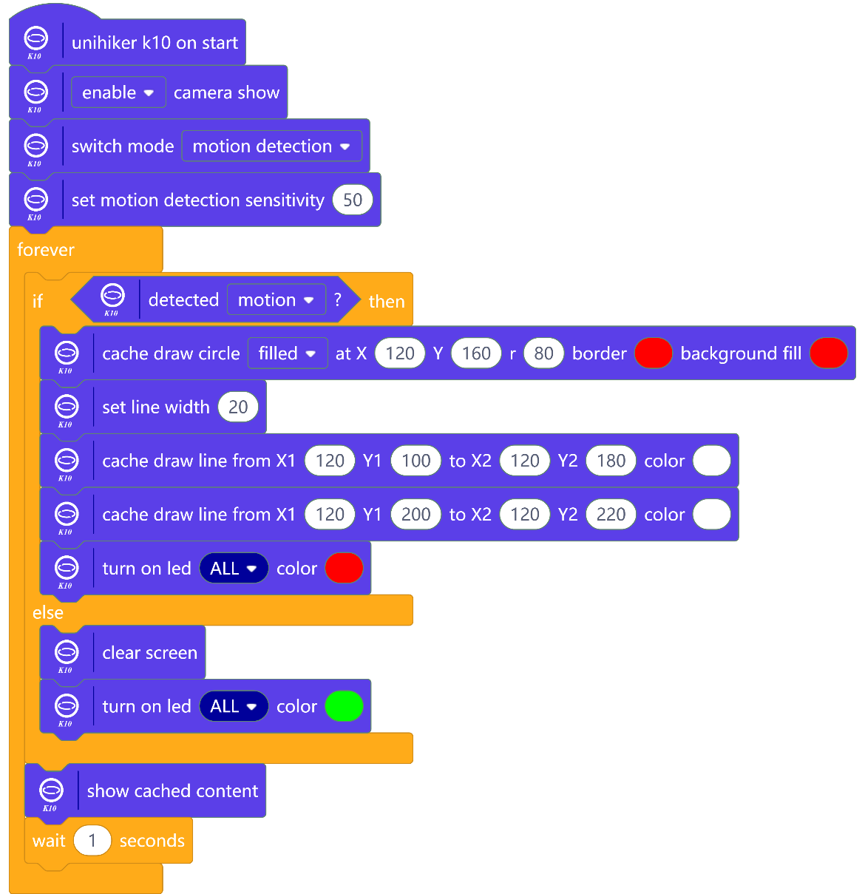
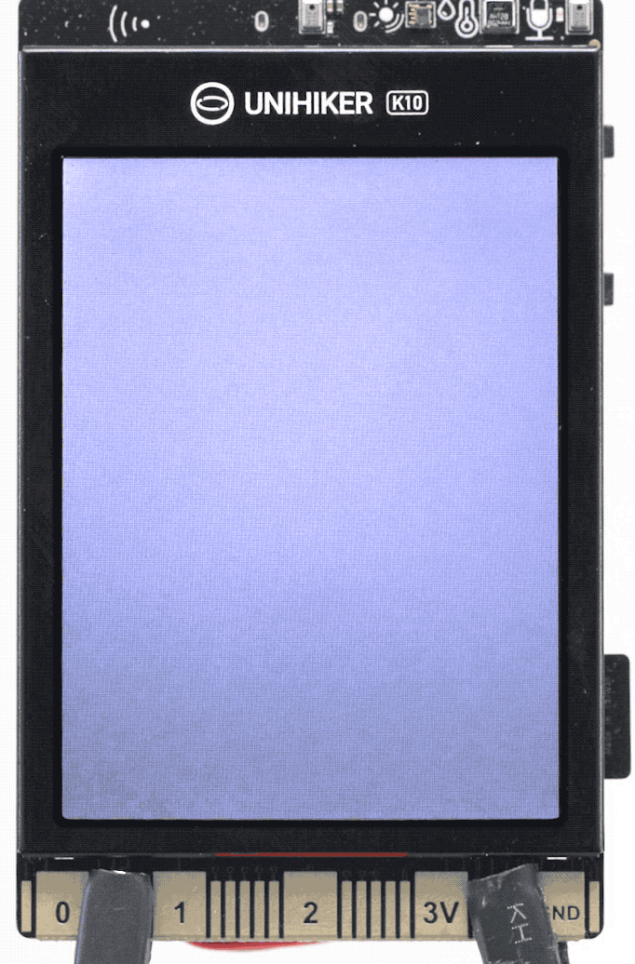
ACTIVITY 7: ARTIFICIAL INTELLIGENCE
MOVEMENT DETECTION
Note: There is a 1 second delay to give the camera time to detect motion.
Notes:
Upload and observe the output on Unihiker k10

Slide 21
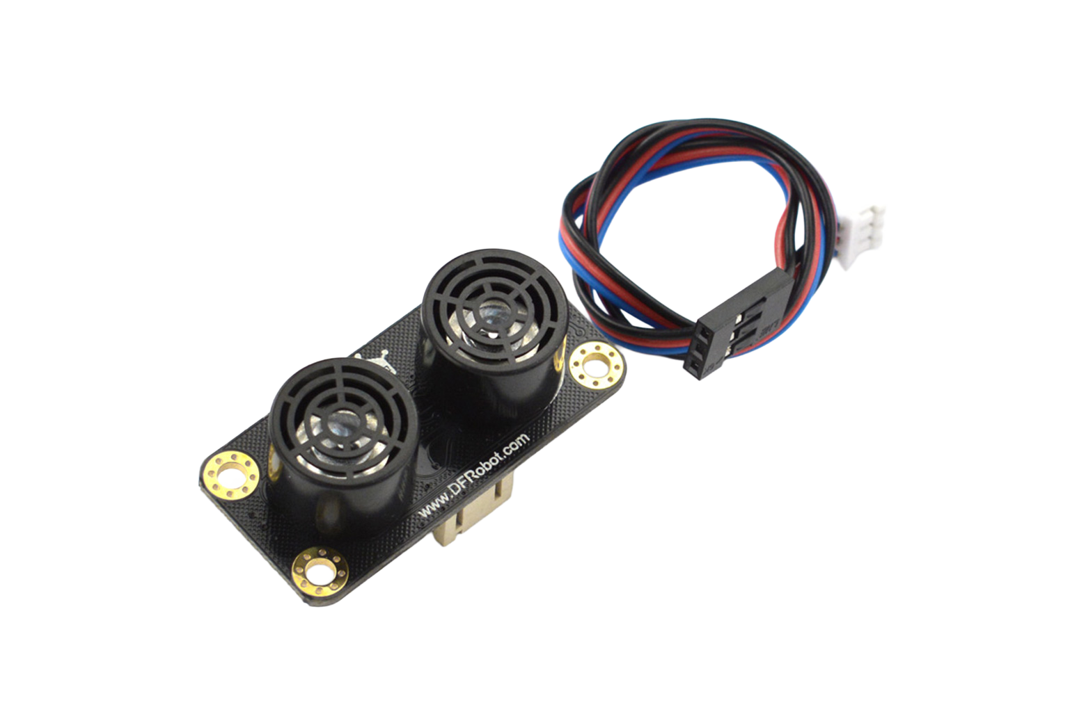
EXTERNAL COMPONNET
ULTRASONIC SENSOR
An ultrasonic sensor is an output device that uses sound to accurately measure distance. It is often used to detect objects.

Slide 22
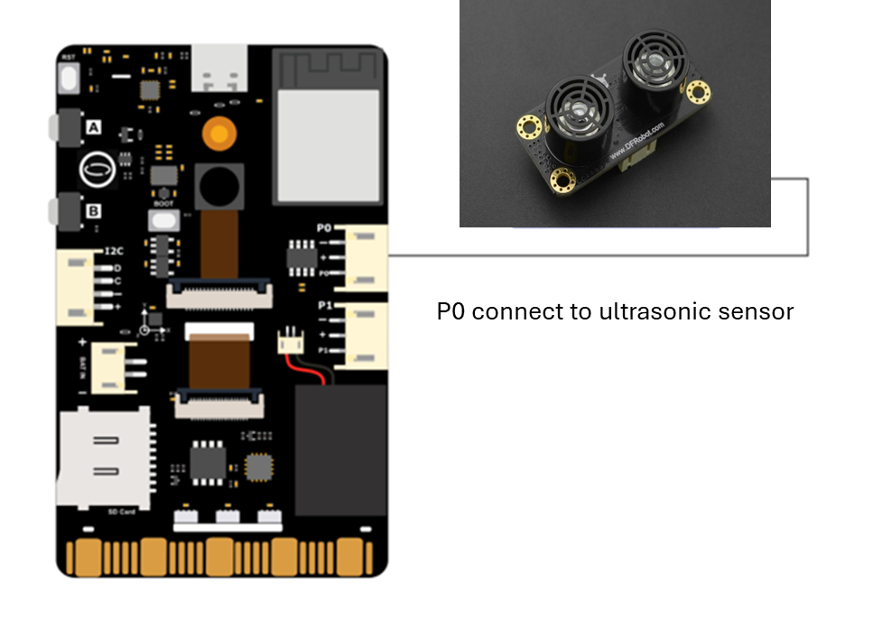
CONNECTION – ULTRASONIC SENSOR TO UNIHIKER K10

Slide 23
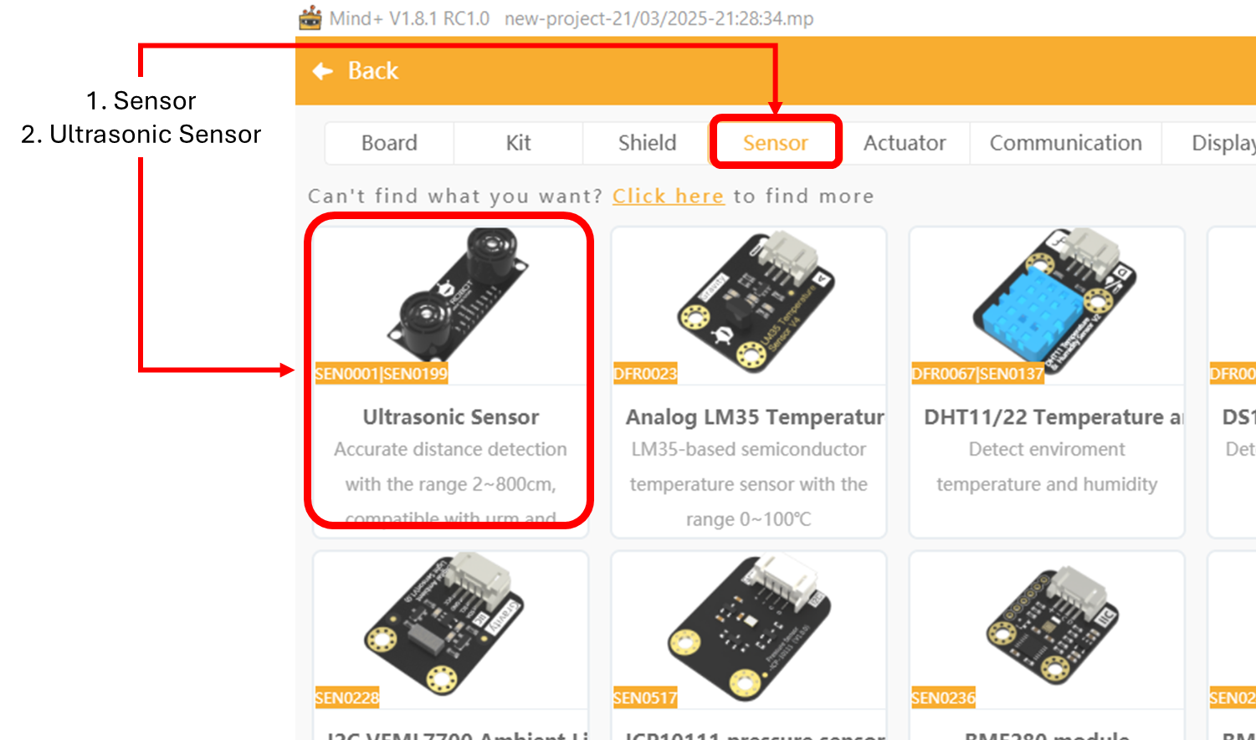
ADDING EXTENSIONS
Click on the [EXTENSIONS] icon on the bottom left corner of Mind+
The list of extensions will be displayed
Click on the [SENSOR] tab
Select the [ULTRASONIC SENSOR] extension
When done, the [ULTRASONIC SENSOR] extension will be found on the code menu

Slide 24
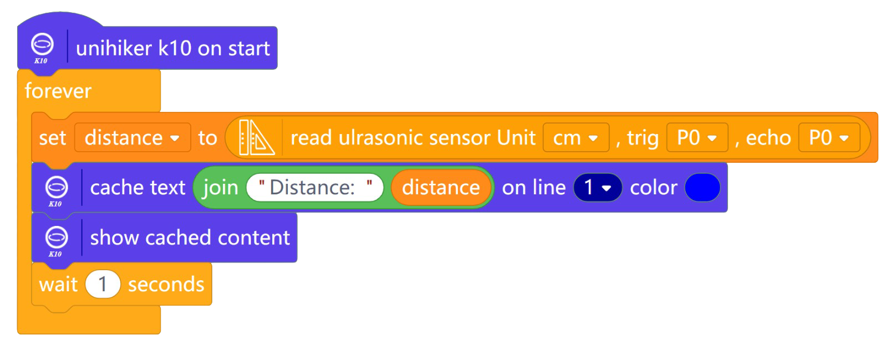
ACTIVITY 8: ULTRASONIC SENSOR
SHOW DISTANCE
The values returned by the ultrasonic sensor is the distance to an obstacle detected by the ultrasonic sensor. The unit of measurement is in “cm” or “inch”.
Upload the above and observe the result on Unihiker K10.
Notes:
Upload and observe the output on Unihiker k10

Slide 25
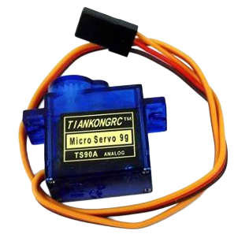
EXTERNAL COMPONNET
SERVO MOTOR
A servo motor is an output device with integrated gears and a shaft that can be precisely controlled. Standard servos allow the shaft to be positioned at various angles, usually between 0 and 180 degrees.

Slide 26
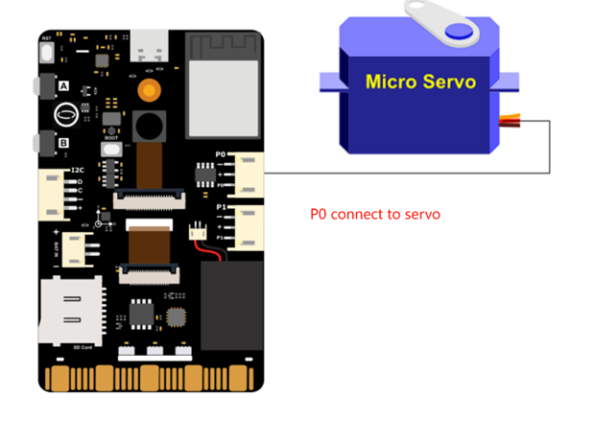
CONNECTION – SERVO MOTOR TO UNIHIKER K10
Note: Remove your previous component from the port. Alternatively, you can slot the servo motor into ‘P1’ slot instead of ‘P0’.
However, the upcoming activities code have to be changed to ‘P1’ accordingly.

Slide 27
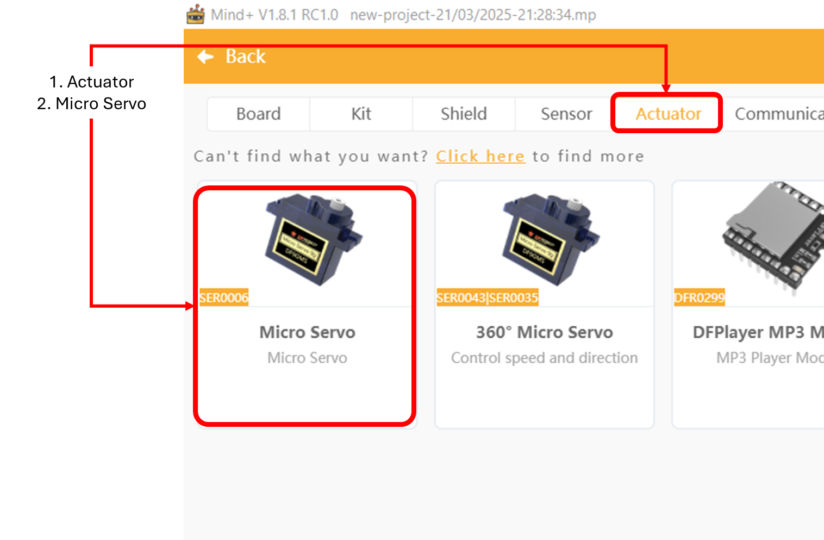
ADDING EXTENSIONS
Click on the [EXTENSIONS] icon on the bottom left corner of Mind+
The list of extensions will be displayed
Click on the [Actuator] tab
Select the [Micro Servo] extension
When done, the [Micro Servo] extension will be found on the code menu

Slide 28
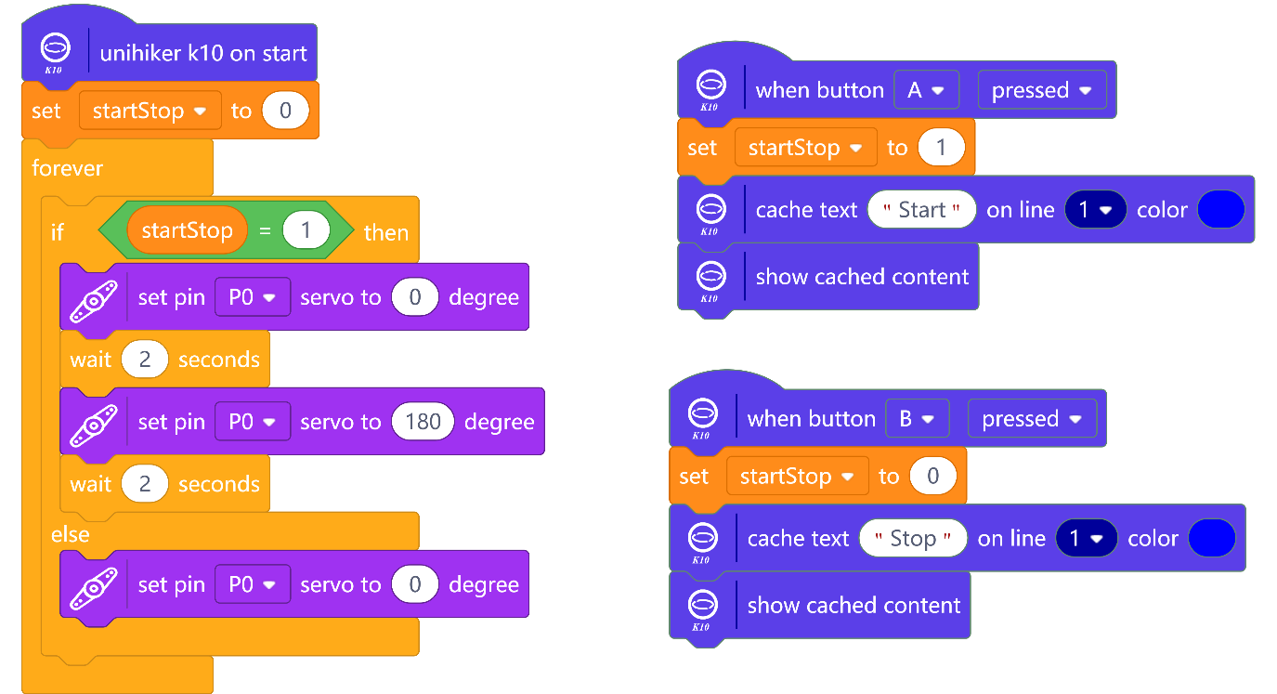
ACTIVITY 9: SERVO MOTOR
WINDSCREEN WIPER
Upload the above and observe the result on Unihiker K10.
Notes:
Upload and observe the output on Unihiker k10

Slide 29
IDEATE: WHAT CAN BE ACCOMPLISHED WITH BOTH ULTRASONIC SENSOR + SERVO WITH UNIHIKER K10

Slide 30

INTERNET OF THINGS
IoT
The Internet of Things (IoT) is the connection of everyday devices to the internet, allowing them to collect, share, and act on data. IoT devices can include sensors, smart gadgets, and machines that communicate with each other to make life easier, more efficient, and more interactive.
In the context of the hackathon, IoT allows students to build projects where devices can sense the environment, send information, and respond automatically—bringing ideas to life in real-world applications.

Slide 31
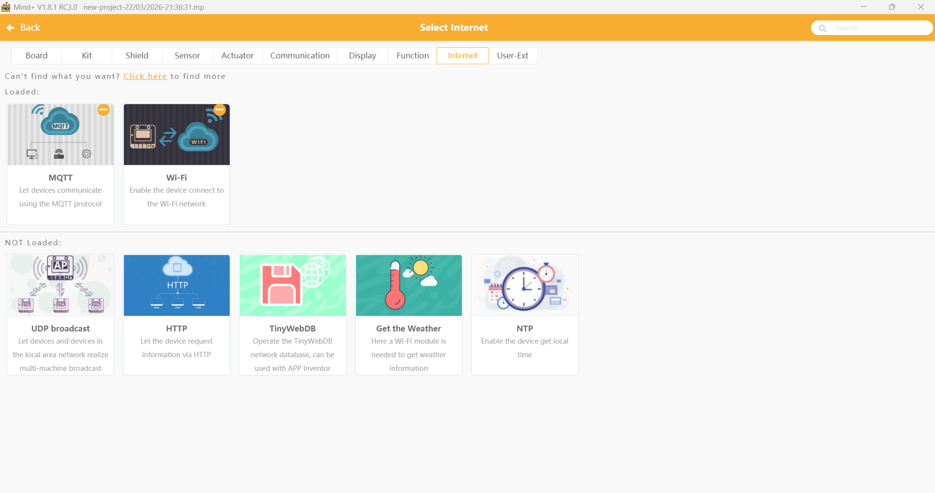
ACTIVITY 10: IOT Project
IOT SMART TEMPERATURE MONITORING SYSTEM
In this lesson, you’ll be guided to build a Smart IoT System. Through temperature sensor integration, MQTT protocol implementation, and IoT (Easy IoT) platform remote control, learners master cross-disciplinary skills in data visualization, hardware programming, and sustainable IoT design – bridging computer science, AI, and environmental science for smart agriculture applications.
Step 1: Ensure you are on ‘Offline’ mode on Mind+
Step 2: Add the Unihiker K10 extension
Step 3: Connect Unihiker K10 to the laptop
Step 4: Add MQTT and Wi-Fi extensions

Slide 32
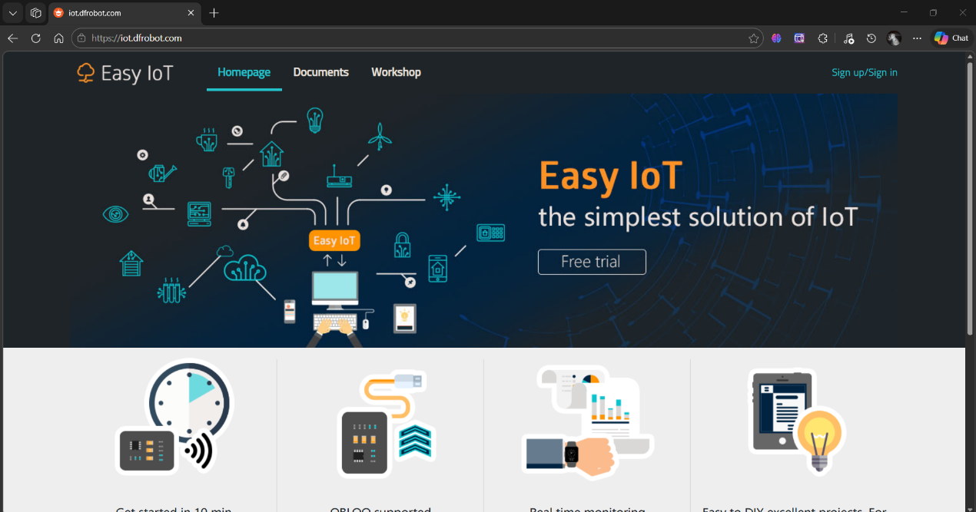
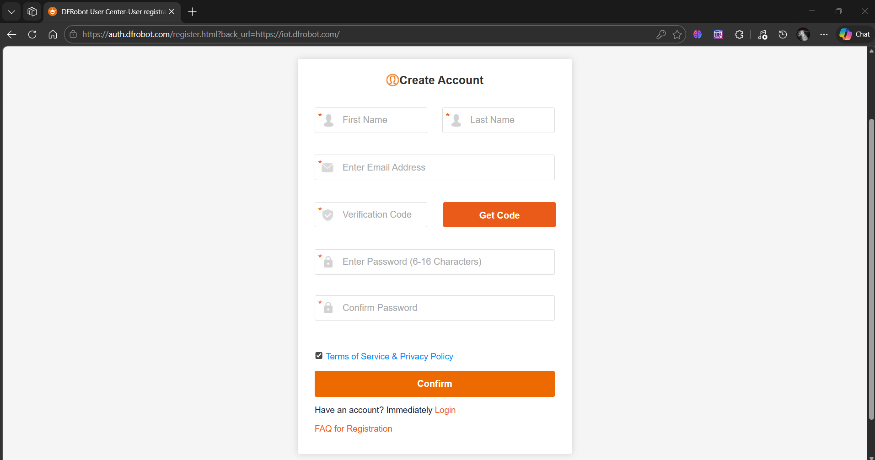
ACTIVITY 10: IOT Project
IOT SMART TEMPERATURE MONITORING SYSTEM
Step 5: Open your web browser (Google Chrome or Microsoft Edge) and visit the following website: https://iot.dfrobot.com
Step 6: Click on ‘Sign up/Sign’ in to create a new account.
Step 7: Fill in the required information, click on ‘Get Code’ to verify email address and click on the Confirm button to create your account.

Slide 33
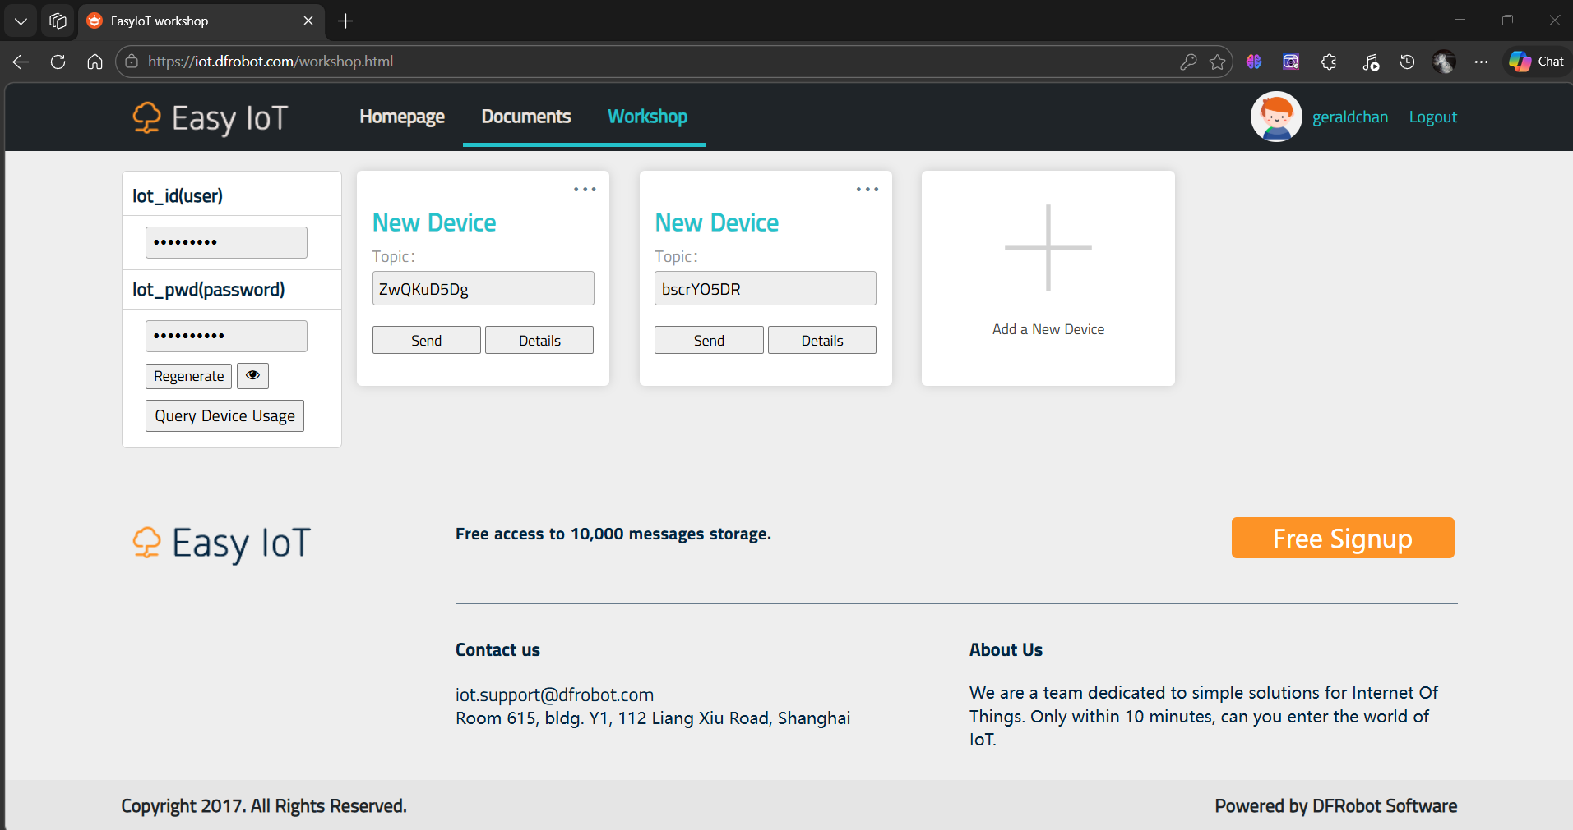
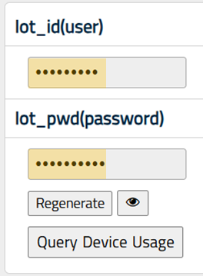
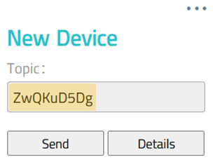
ACTIVITY 10: IOT Project
IOT SMART TEMPERATURE MONITORING SYSTEM
Step 8: Upon completion of sign up and login. Click on the Workshop link to view the IoT platform functions. Click on ‘Add a New Device’ to create a new topic.
Step 9: Please take note of the following highlighted information. We will need the values in our setup later on Mind+

Slide 34
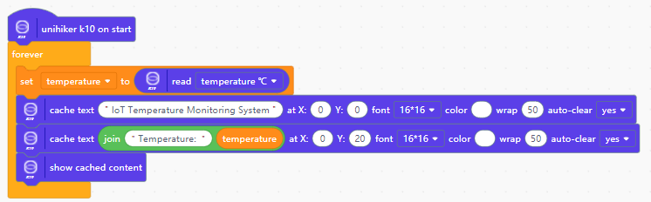
ACTIVITY 10: IOT Project
IOT SMART TEMPERATURE MONITORING SYSTEM
Step 10: At Mind+, we will start our coding to read the temperature data. After collecting data, we will create corresponding variable to store the value and display the value on the screen.

Slide 35
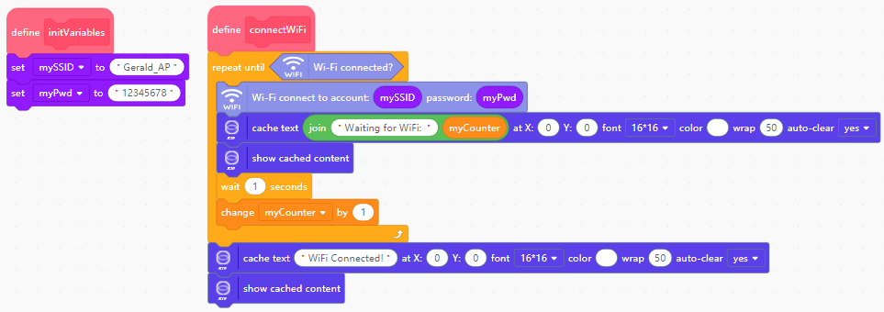
ACTIVITY 10: IOT Project
IOT SMART TEMPERATURE MONITORING SYSTEM
Step 11: To enable data transmission, we first need to establish a network connection. Complete the code below.
Step 12: Change the Wi-Fi credentials that is being given respectively.

Slide 36
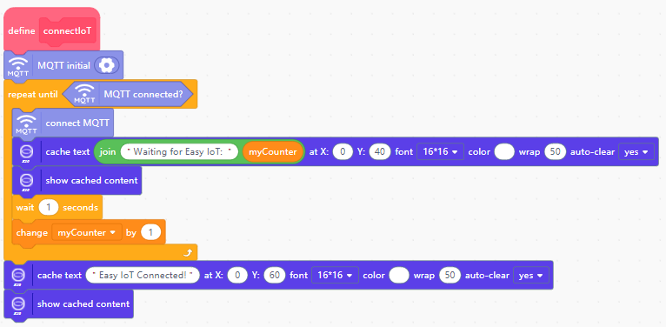
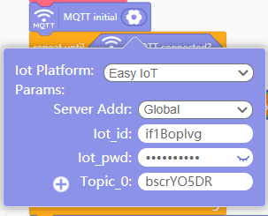
ACTIVITY 10: IOT Project
IOT SMART TEMPERATURE MONITORING SYSTEM
Step 13: To initialize the parameters for MQTT, create a function called "connectIoT". Ensure the connection values in the MQTT settings are the same as what is found on your Easy IoT account. (The highlighted values previously on the platform)

Slide 37
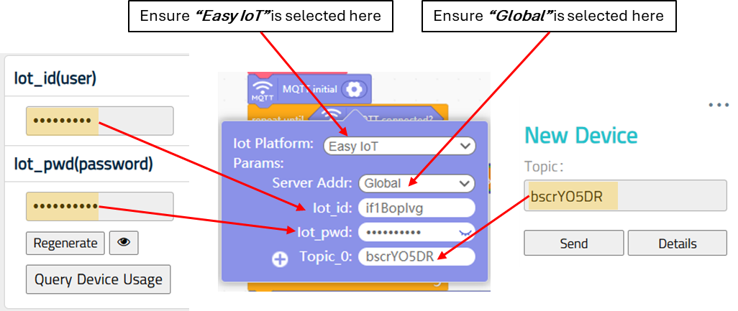
ACTIVITY 10: IOT Project
IOT SMART TEMPERATURE MONITORING SYSTEM
Step 13: Cont.

Slide 38

ACTIVITY 10: IOT Project
IOT SMART TEMPERATURE MONITORING SYSTEM
Step 14: Edit your code with the following:
New
Completed setup at previous step

Slide 39
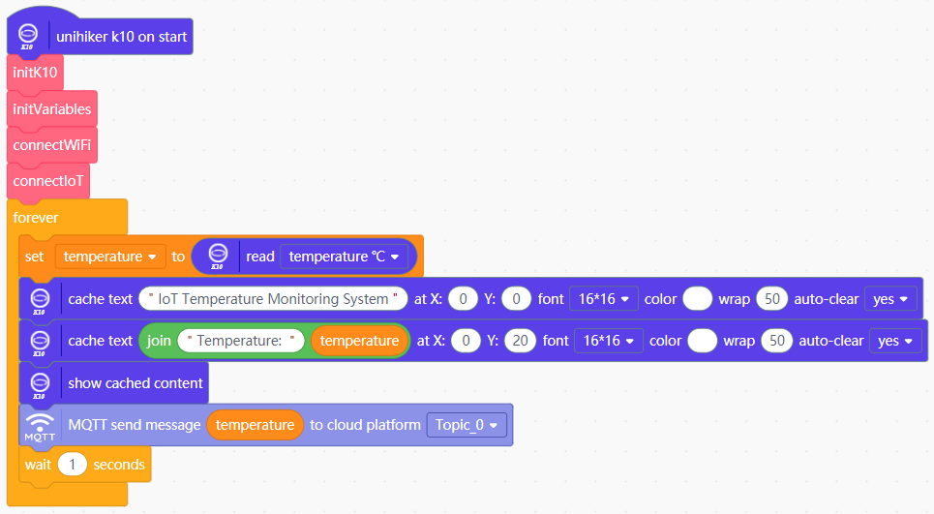
ACTIVITY 10: IOT Project
IOT SMART TEMPERATURE MONITORING SYSTEM
Step 15: Edit your code with the following:
New

Slide 40
ACTIVITY 10: IOT Project
IOT SMART TEMPERATURE MONITORING SYSTEM
Final Code (Part 1)

Slide 41
ACTIVITY 10: IOT Project
IOT SMART TEMPERATURE MONITORING SYSTEM
Final Code (Part 2)

Slide 42


ACTIVITY 10: IOT Project
IOT SMART TEMPERATURE MONITORING SYSTEM
Step 16: Upload the code to the Unihiker K10
Step 17: Observe the results on the UNIHIKER K10 screen and on the Easy IoT Platform on the web browser.
Data sent from Unihiker K10 to the Cloud

Slide 43

ACTIVITY 10: IOT Project
IOT SMART TEMPERATURE MONITORING SYSTEM
Step 18: Receiving message from the Cloud (Easy IoT platform)
Step 19: Add the following to your previous completed code:
Step 20: Upload the code to the Unihiker K10

Slide 44

ACTIVITY 10: IOT Project
IOT SMART TEMPERATURE MONITORING SYSTEM
Step 21: On the Easy IoT platform, click on ‘Send’ for the connected Topic with your project.
Step 22: Observe the output on your Unihiker K10. If the message is sent successfully to it from the Cloud, the LED should be light up with red colour.

Slide 45

REAL-LIFE APPLICATION
IOT PROJECT

Slide 46

DESIGN THINKING
PRINTED WORKSHEET
Design Thinking is a problem-solving approach that focuses on understanding people’s needs and creating meaningful solutions. It encourages you to explore ideas, test them, and improve along the way.
In this hackathon, Design Thinking will guide you to:
- Understand the problem and who you are helping
- Come up with creative ideas
- Build and test your solution
- Improve your ideas based on feedback
By following this process, you can create solutions that are not only functional, but also thoughtful and impactful.

Slide 47
REMINDER: TO THINK LIKE A PROBLEM SOLVER
Problem: Something isn’t working as expected.
Step-by-Step Decomposition:
Observe the problem carefully – What is happening? What is not happening?
Break the problem into smaller parts – Identify possible areas (e.g., device, software, connection, settings).
Test each part individually – Check one component at a time to isolate the issue. (from easiest to hardest)
Analyze the results – Which part is causing the problem?
Apply a solution logically – Fix the specific issue step by step.
Verify everything works – Test the whole system again.
Key Idea: By breaking a complex problem into smaller steps, you can solve it efficiently and systematically instead of guessing randomly.

Slide 48
YOUR HACKATHON JOURNEY
Remember, this hackathon is about more than just the final outcome — it’s about your journey of learning, experimenting, and growing. Embrace challenges, stay curious, and work together as a team.
Take ownership of your ideas, think like a problem solver, and most importantly, enjoy the process of creating something meaningful.

